Slide 1


Project Pangaea
Alexandrea Cooney-Uribe
Mentor: Dr. Michael Crimmins, Department of Soil, Water, & Environmental Science
Climate Assessment for the Southwest (CLIMAS)
Arizona Space Grant Symposium 2014, University of Arizona

Slide 2
What is Project Pangaea?
Public Awareness Campaign for climate change expectations going into the future
Southwest Climate Change Assessment Report (SWCCAR) and similar documents
Compact the information
Technical meets Universal

Slide 3
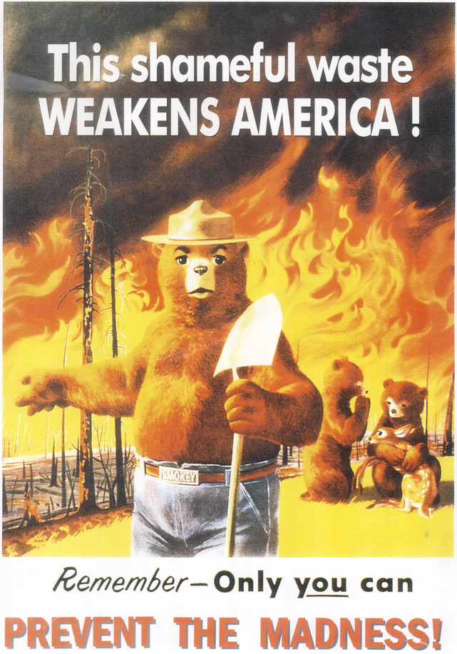
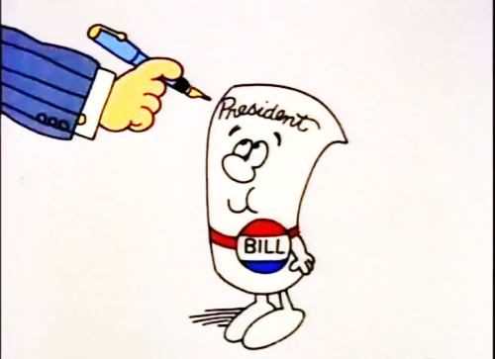
Animation Still, School House Rock: I’m Just a Bill, 1975
Smokey Bear Vault. Prevent the Madness, 1953

Slide 4
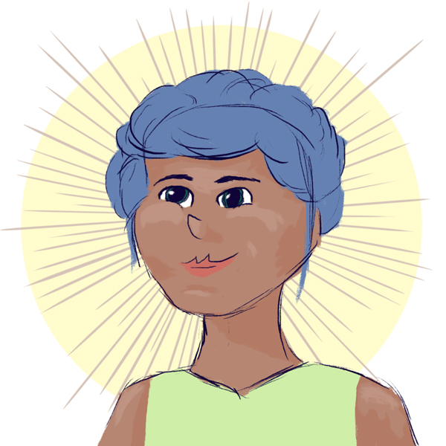
Hello!
Cooney-Uribe, Alexandrea. Preliminary Gea Character Design, 2014.

Slide 5
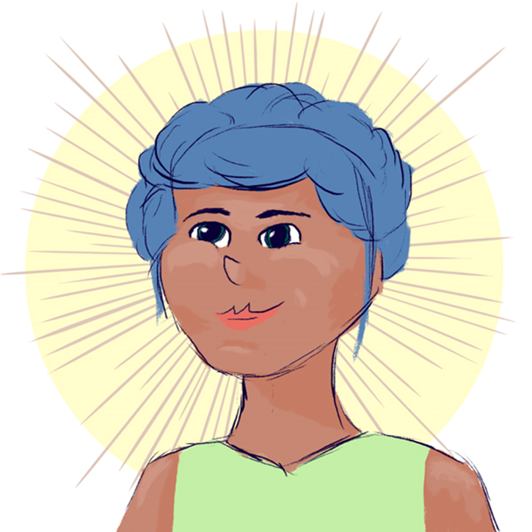
Pangaea (Gea)
Time-traveler from 2060
Explores the geological regions of the United States
Expectations Education
Adaptability
Notes:
come to the present to educate us about changes in the future

Slide 6
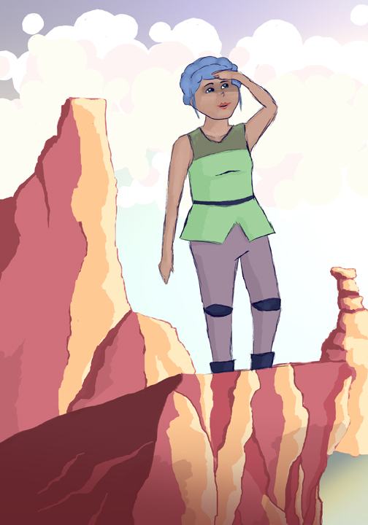
Graphic Novels
TV spots
Saturday morning cartoons
Online Games
Infographics
Alexandrea Cooney-Uribe. Gea Concept Art: Exploration, 2014.
Notes:
Rings of the same impact as School House Rock, Smokey the Bear PSAs, etc.

Slide 7
Goals
Raise appreciation for regional environments
Raise acknowledgement of global climate changes, both natural and influenced
Women as lead characters to pull more women into STEM fields of study
Convey climate information in a novel way

Slide 8
Thank you!

